Slide 1
The autism Spectrum
Effective Teaching and classroom management strategies
Dr Emma Goodall
Healthy Possibilities pty ltd

Slide 2
Effective teaching of autism Spectrum Students is:
Not related what you know
But is correlated to what you understand
Also correlated to positive interpersonal relationships (Goodall, 2013)

Slide 3
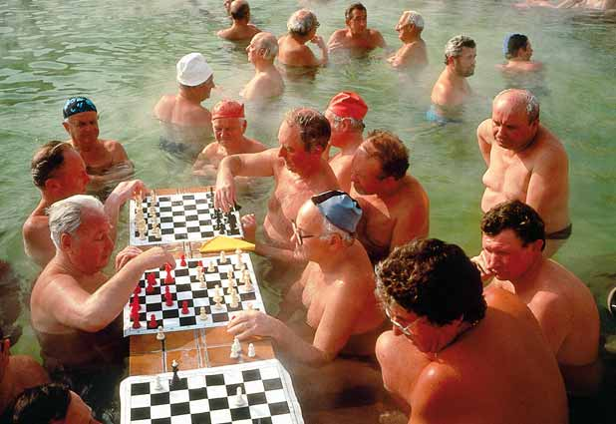
Experience is relative and there are multiple realities….
Is it HOT or not?

Slide 4
Sensory Inputs
Sight
Sound
Taste
Touch/texture/feel
Smell
Vestibular – sense of balance
Proprioception - sense of where our body is in space

Slide 5
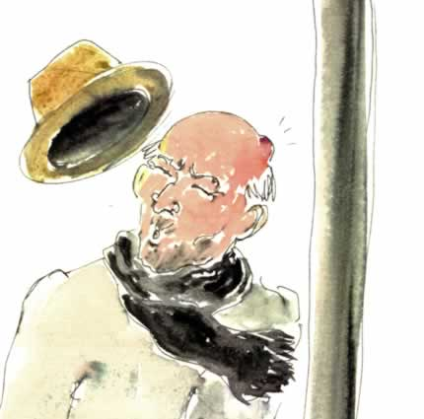
Autism spectrum sensory issues
It is very difficult to know if different interpretations of and reactions to sensory input are due to differences in input or in the processing.
Even when vision is screened and found to be 20/20 issues such as:
lack of peripheral vision
poor depth perception
can exist in many people on the Autism Spectrum.

Slide 6
Sensory input is perceived as either muted and/or intensified compared to typical people – this is often referred to as hypo and hyper sensitivity
This leads to experiential differences
This also helps explain sensory sensitivities and sensory seeking and/or avoiding behaviours

Slide 7

http://vimeo.com/52193530

Slide 8

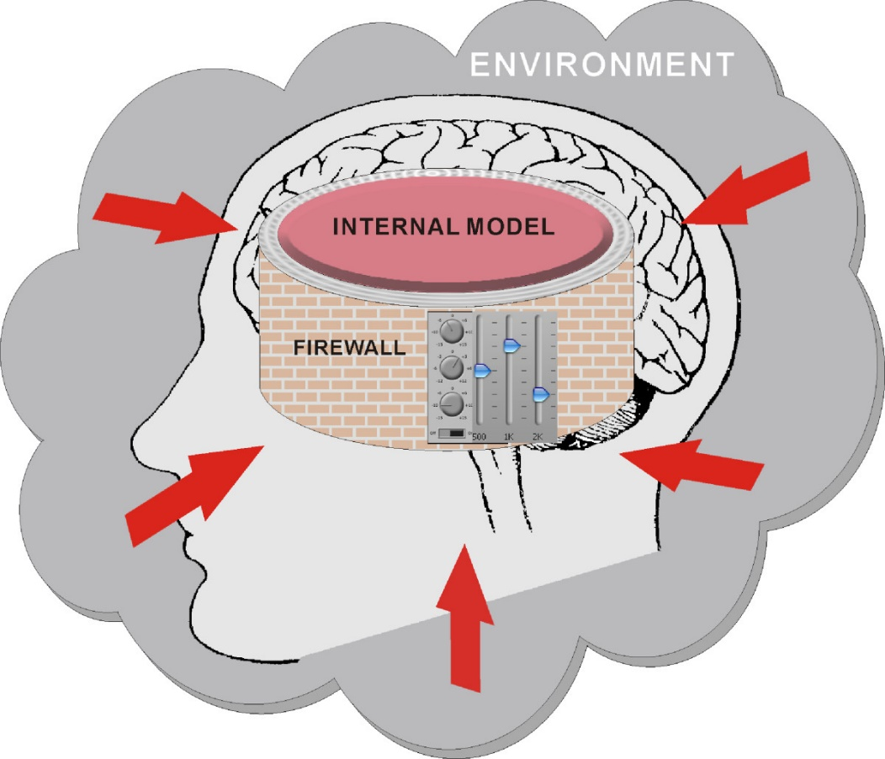
Typical people are able to both filter and prioritise sensory input. People on the autism spectrum struggle to do this and can easily become overwhelmed.

Slide 9
Communication issues
From hyperlexia to non-readers/writers
From non-stop talking to non-verbal
The issues in common are:
A lack OF or mis-understanding of:
what, HOW and why to communicate
A literal and hyperlogical understanding of language
A different socio-emotional framework for language
Auditory processing issues
Competing sensory input masks incoming sounds

Slide 10
Other communication issues
The ability to speak can be hindered by emotional and or sensory overload
Not being able to speak is not the same as having nothing to say
Visuals and other AAC tools are only useful if everyone can use them – everyone can learn together
Hidden meanings are lost
Too much information can end up as too little information

Slide 11

c

Slide 12
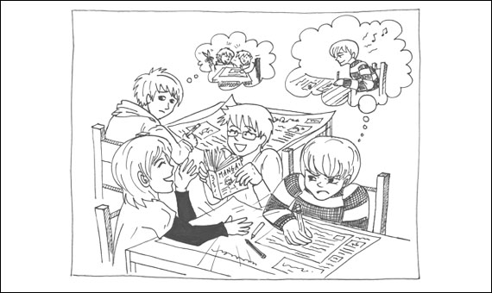
Would you like to?
Do your maths now? NO
Come inside now? NO
Apologise to Sarah? NO

Slide 13
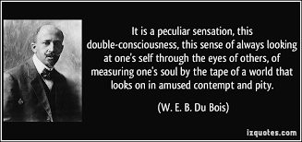
SOCIAL cognition (sense of self and others) is a huge part of communication.

Slide 14
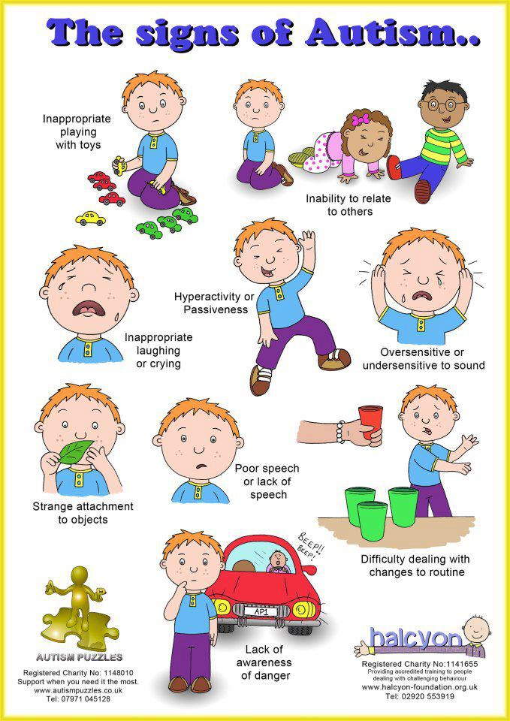
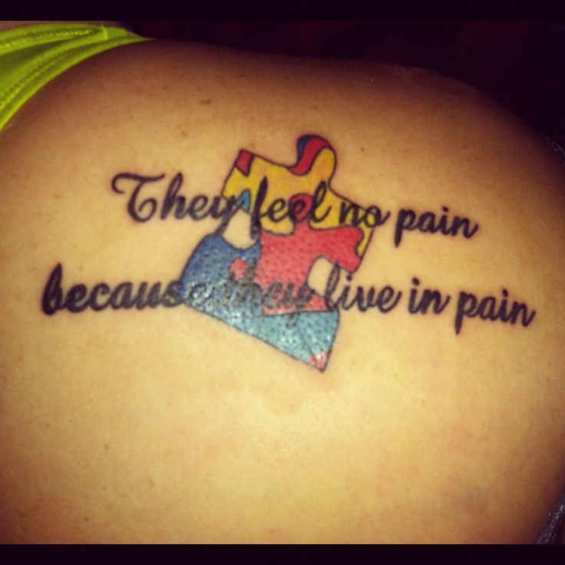
Messages that lead to negative sense of self

Slide 15

Creating a positive sense of I to support positive interpersonal relationships.
Talk respectfully to and about – it will make a huge difference.

Slide 16
Principal - most important person to be obeyed at all times
Teacher - very important person to be obeyed unless there is a contradictory order from principal
Students - least important people in a school. Students should prioritise rules and instructions from teachers over those of other students
Typical perception of school hierarchy
ME
Example of autistic spectrum perception of school hierarchy
Everyone else
Everything else

Slide 17
Other communication issues
Contextual Clues | Issues for those on the AS
Facial expressions and other body language clues | May be entirely missed or misinterpreted
Tone of voice | May not be heard or may be misinterpreted
Place and time contexts | Fixated thoughts and rigid thinking: if Mr X did Y once then Mr X is always going to do Y
Importance of the big picture | Excellent observation of the small details but difficulty assembling into the same interpretation of the big picture as non AS people

Slide 18
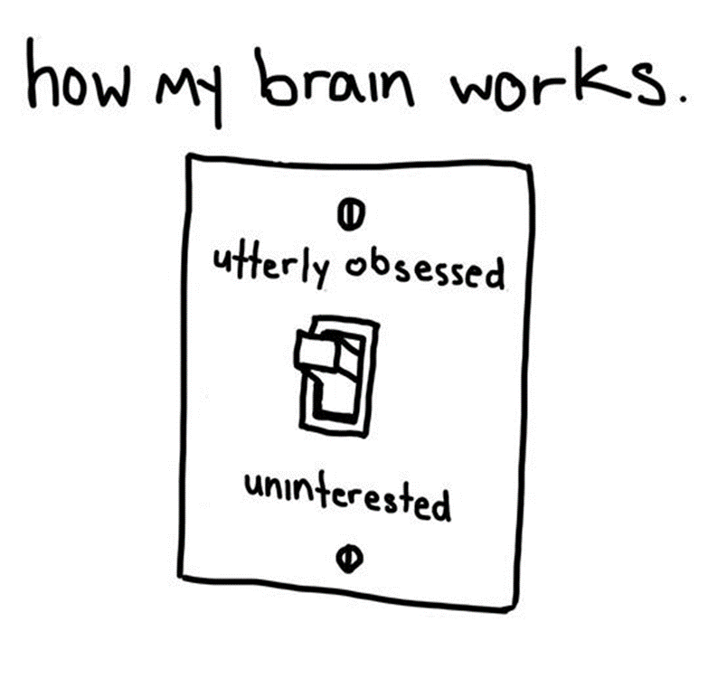
Can’t or won’t
Instruction is not understood or received
task is too hard
Student is overwhelmed
Student is preoccupied with sensory or emotional input
Task is too easy
Thinks task it too hard
Task is uninteresting
Does not want to work with a particular student or group of students due to prior bad experiences.

Slide 19
If you spark the interest of aN Autistic spectrum student:
They will focus
They will engage
They will try harder
They may share/teach others
Their knowledge and skills can be increased through broadening/deepening the topic/subject

Slide 20
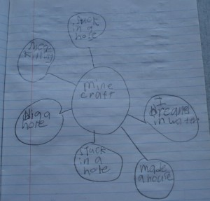
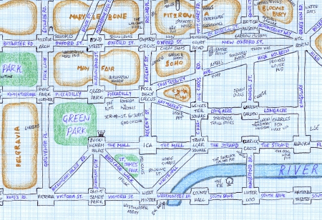

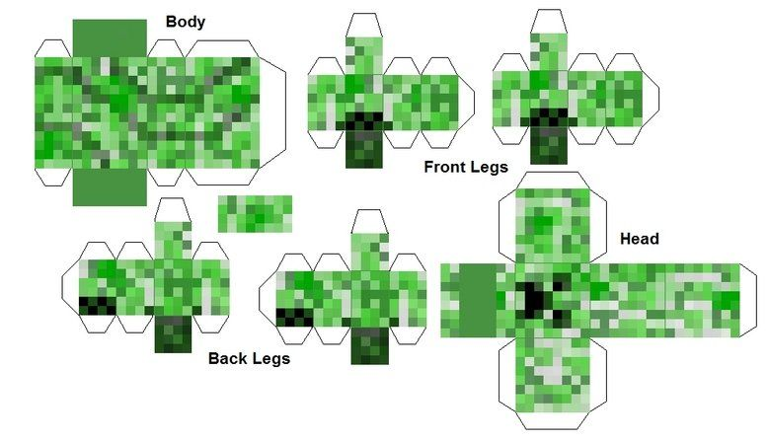
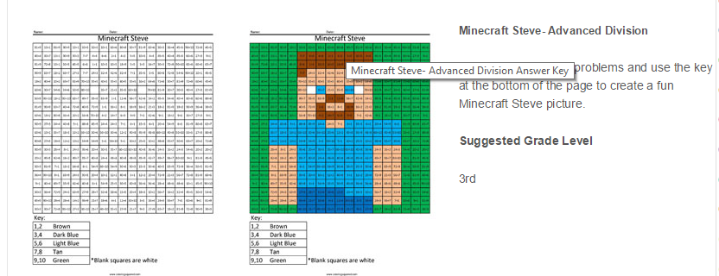
LITERACY
DANCE & MUSIC
Design and build a working roller coaster in Minecraft. Do experiments on acceleration and velocity.
GEOGRAPHY
ART/CRAFT
PHYSICS
MATHS

Slide 21
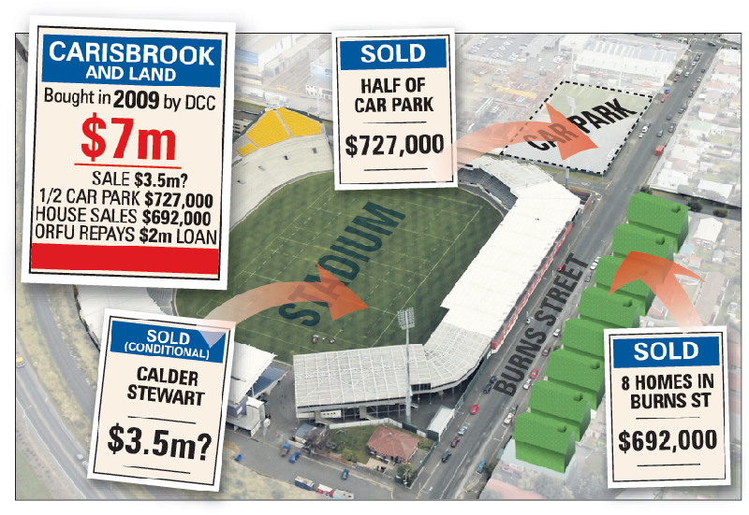

Using special interests/passions
Student will work
Student will work for longer
Student will work at a higher level
Interpersonal relationships will improve
Student will feel more positive about school

Slide 22
Behaviours of concern
Self harm
Harming others
Damaging property
Flapping, rocking, other stims, lack of eye contact, echolalia and using non-verbal communication ARE NOT BEHAVIOURS OF CONCERN

Slide 23
Avoiding confrontations
Many people on the autism spectrum intensely dislike confrontation and will try to avoid it
In order to avoid it they may; run away or lie
Being fair and gaining the person’s trust is vital to prevent these behaviours

Slide 24
Creating confrontations
- aggression &/or violence
Some people on the autism spectrum seem to enjoy confrontations
They may exhibit a number of aggressive or violent behaviours
This may not have anything to do with creating confrontations at all
It is important to work out why they engage in these behaviours

Slide 25
Sensory seeking/avoiding
People on the autism spectrum will actively seek out pleasurable or calming sensory experiences and try to avoid unpleasant or horrific experiences
This can result in behaviours that are viewed as problematic such as; running away, hitting out, screaming, touching others or things inappropriately

Slide 26
To prevent sensory input causing behaviours of concern
DO a sensory screen - at school and at home
Ensure strategies are noted down for any sensory issues
Ensure there is at least one self-calming strategy suitable for school and for in the community as well as at home
USE these strategies proactively
Update the screen twice a year in primary school and yearly in high school
(you are welcome to photocopy the sensory screen in Goodall, 2013)

Slide 27
Problem solving behaviours of concern
Collect data
Prioritise issues according to safety of self and others, property, no safety issues
Look at why the individual may be engaging in that behaviour and what it might be designed to communicate
Examine who it is a concern for and why

Slide 28
Problem solving behaviours of concern
With the team:
Plan the replacement behaviour
Structure how to introduce replacement behaviour and reduce behaviour of concern
Explain/discuss with the person again (should be involved from beginning)
Start process

Slide 29
Replacement behaviours
You cannot just eradicate a behaviour
You must teach a suitable replacement behaviour (suitable for the person and the context)
Don’t forget ALL behaviour is functional – the replacement behaviour MUST meet the same functional expression and sensory needs of the person

Slide 30
Replacement behaviours
May need to be a number of interim steps between old and replacement behaviours
May need to scaffold
May need to be heavily reinforced and/or prompted
Can be surprisingly easy to implement*

Slide 31
* Easy shortcuts
If you do x – then you can have y, where Y is meaningful
It makes me/your mum/the class/z (meaningful person) really happy when you do x. please do x.
I really like it when…. (only works if the AS student likes you and believes you like them)

Slide 32
Data collection
Observations need to ascertain:
What exactly is the behaviour of concern?
What are the precipitating events?
How frequently is it occurring?
What are the consequences?

Slide 33
Data analysis
Analysis needs to ascertain:
Function of the behaviour (or likely function)
Sensory need behaviour meets
Who behaviour is a concern for and WHY

Slide 34
Input from the individual
Ask direct and non-judgemental questions
Give time to process and respond
Describe what you saw and ask for their interpretation
Explain your interpretation afterwards
Explain why behaviour is a concern

Slide 35
Setting goals
Goals need to:
Detail replacement behaviour and usage
Set frequency decrease for behaviour of concern
Decrease difficulties long term whilst MINIMIZING anxiety/distress for the person
Detail reinforcers, prompting and scaffolding

Slide 36
Environmental modifications
Sometimes the environment triggers behaviours of concern
Easiest and quickest solution is to modify the environment (eg remove hand dryer from school bathroom)
Desensitization requires professional psychological/psychiatric input

Slide 37
School Years
Throws things including furniture
Refuses to clean up the resulting mess
- Teacher thinks he is being naughty and that he “trashes the room when he is told he can’t do or have something he wants”

Slide 38
Data collection for schoolchild
5-10 times a day he throws his books and/or pencils etc across the room, always at transition between tasks or breaks in class.
2-3 times a day he then picks up his chair and/or desk and throws them.
5 – 7 times a week after throwing chair he will upend boxes of books and pull over storage shelves and rubbish bin

Slide 39
Data analysis for schoolchild
Transition and break times are causing severe anxiety
Does not know how to signal this anxiety appropriately
Does not escalate when his aide/support worker says “books away, mat time”
Escalates when aide/support worker not there.
Severe escalation occurs prior to lunch and end of school on days Mum is not picking him up

Slide 40
Goal & Plan
Goal | Strategies | Prompts to be used | Reinforcers
To know who is going to pick him up every day | Visual on his table of 3pm plus photo and name of person picking him up that day (mum to do this every morning with him on arrival) | “Great, x is picking you up today.” “We can tell x about your great ….. when they pick you up today.” | Good behaviour certificate to be presented at end of day to the person picking him up.
To not throw his books/pencil etc | Provide first/then visuals Warn him 5 then 1 minute before transitions | “First a, then mat time” “In 5/1 minute you need to stop work and sit on the mat.” | Smiles, stickers for coming to sit on mat without throwing things.
Evaluate playground at lunch to find out what is causing him anxiety | Support worker or teacher to observe lunch play for 2 weeks then analyse data | n/a | n/a

Slide 41
Young Adult
Strokes hair on females who are standing/sitting close to him
Sniffs hair on females who are right next to him
- Parents are worried this is an inappropriate expression of sexuality

Slide 42
Data collection for young adult
Only strokes hair on long haired females with ‘silky’ hair
Only smells hair that has been washed with ‘Silkesssence’
Tries to bury nose into this type of hair
Gets distressed when asked to stop or physically stopped
Says he loves that particular smell and the feel of that texture

Slide 43
Data analysis for young adult
Sensory seeking pleasurable sensory experiences of stroking long silky hair and smelling air washed in a particular brand of shampoo
Does not seem to have and sexual components/intentions of this behaviour
States he likes the smell and the feel

Slide 44
Goal & Plan
Goal | Strategies | Prompts to be used | Reinforcers
To not stroke other people’s hair | Provide him with a bracelet made of silky hair extensions (bought from hair shop) Distraction – ipad with minecraft on it | “What does your bracelet feel like?” “Can you show me what you built in Minecraft last night?” | Extra time on the ipad (5 mins for each instance of not touching hair of females close to him)
To not sniff other people’s hair | To wash his own hair and his hair bracelet in ‘Silkessence” | “Do you need to wash your bracelet again?” | As above
To wear his ‘hair bracelet’ | Take him to hair shop, let him choose the hair and help to make the bracelet (braided or macramé) | “Do you like this one?” “Does this one feel nice?’ | He gets to choose and make his own bracelet.

Slide 45
Reasons for self-harm
Only way person feels they exist
Stops emotional pain from being as painful
Side effects of medication
Provides sensory pleasure

Slide 46
Self-harm issues
Can escalate over time
Can cause serious and permanent damage
Requires professional intervention (psychologist/psychiatrist)
Side effects of medication MUST be investigated

Slide 47
Reasons for harming others
Only way person feels they exist
An expression of emotions
Does not know it is unacceptable/illegal
Trying to get own way
Trying to defend self or others

Slide 48
Issues around harming others
Can escalate over time – important not to let children continue to harm others
Can result in prison/jail
Need to be sure person is not being bullied/abused and is just trying to protect self and/or others
Can result in alienation and loneliness which can lead to mental health issues

Slide 49
OTHERS
People on the autism spectrum are at a higher risk of all kinds of abuse than other people.
People on the autism spectrum have higher risk for anxiety, depression and suicide than other people.
Bullying can have devastating life long impacts
Saying that someone on the autism spectrum will never achieve or be able to have friends/a family in front of them can also have devastating life long impacts

